Slide 1
CHAPTER 1 Introduction to Computer Networks
Notes:
Our goal:
get “feel” and terminology
more depth, detail later in course
approach:
use Internet as example

Slide 2
OUTLINE
About the course
What’s the Internet?
What’s the protocol?
Network edge: hosts, access network, physical media
Network core: packet/circuit switching, Internet structure
Network topology
Network Performance: loss, delay, throughput
Internet Structure
OSI model & TCP/IP model

Slide 3
1. About the course

Slide 4
ABOUT THE COURSE
Title: COMPUTER NETWORKS
Period: Semester I, 2020 – 2021
Google Classroom: 18Nh1x – Computer Networks
Assignments:
Need to finish before deadline
Submit on Classroom
A missing assignment = -2 points in Mid-term exam
Mid-term exam: Multiple choices or Writing
Final exam: Multiple choices
Lecturer: PhD. Le Tran Duc
Research Interests:
Networking, FANET, VANET, LoRaWan, WLAN
Network Security, Malware Analysis
E-mail: letranduc@dut.udn.vn & Tel: 0931733853
Notes:
x = 4 → Class code 7gq6fu4
x = 5 → Class code v3x5yvk
Introduce the Google Classroom

Slide 5
REFERENCES
Slides & Notes from lecturer
Kurose, J., & Ross, K. (2017). Computer Networking: A Top-Down Approach, Global Edition.
Nguyễn Tấn Khôi (2004). Giáo trinh môn học Mạng máy tính. Trường ĐHBK - ĐHĐN
Tanenbaum, A., & J Wetherall, D. (2011). Computer Networks.
Forouzan, A. B. (2012). Data communications & networking (sie). Tata McGraw-Hill Education.
Forouzan, B. A., & Mosharraf, F. (2012). Computer networks: a top-down approach (p. 931). McGraw-Hill.
Forouzan, B. A. (2010). TCP/IP protocol suite. McGraw-Hill, Inc..

Slide 6
2. What’s the Internet?

Slide 7
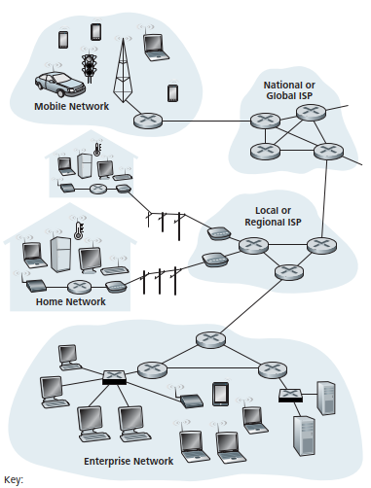







WHAT’S THE INTERNET: “NUTS & BOLTS” VIEW?
Billions of connected computing devices:
hosts = end systems
running network apps
Communication links
fiber, copper, radio, satellite
transmission rate: bandwidth
Packet switches: forward packets (chunks of data)
routers and switches
PC
server
wireless
laptop
smartphone
wireless
links
wired
links
Notes:
Nuts and bolts: Những nhân tố/thành phần cơ bản
Further reading: The future of the internet – And how to stop it (Jonathan Zittrain)
In many ways, packets are analogous to trucks, communication links are analogous to highways and roads, packet switches are analogous to intersections, and end systems are analogous to buildings. Just as a truck takes a path through the transportation network, a packet takes a path through a computer network.

Slide 8
WHAT’S THE INTERNET: “NUTS & BOLTS” VIEW?
Internet: “network of networks”
Interconnected ISPs
Protocols control sending, receiving of messages
e.g., TCP, IP, HTTP, Skype, 802.11
Internet standards
RFC: Request for comments
IETF: Internet Engineering Task Force

Slide 9
3. What’s the protocol

Slide 10
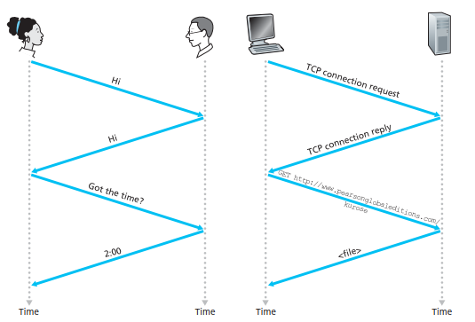
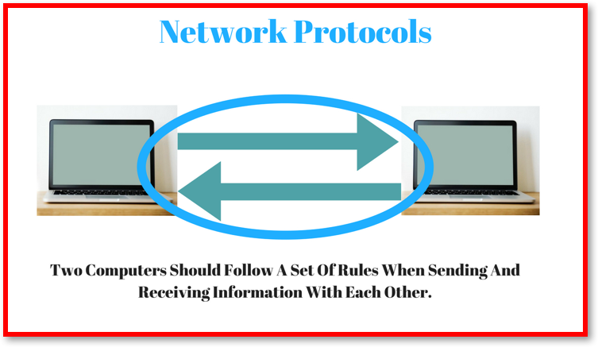
WHAT’S A PROTOCOL?
Human protocols:
“what’s the time?”
“I have a question”
introductions
… specific messages sent
… specific actions taken when messages received, or other events
Network protocols:
machines rather than humans
all communication activity in Internet governed by protocols
protocols define format, order of messages sent and received among network entities, and actions taken on message transmission, receipt

Slide 11
4. Network STRUCTURE

Slide 12
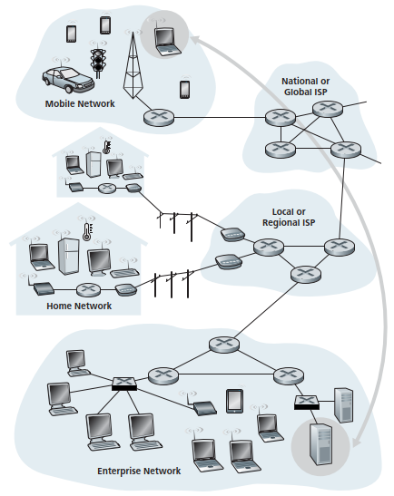
A CLOSER LOOK AT NETWORK STRUCTURE
Network edge:
hosts: clients and servers
servers often in data centers
Access networks, physical media:
wired, wireless communication links
Network core:
interconnected routers
network of networks
End-system interaction

Slide 13
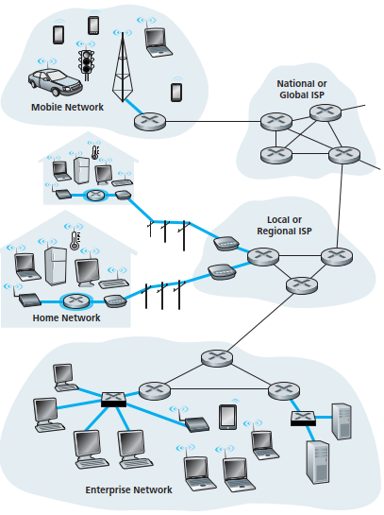
ACCESS NETWORK
Q: How to connect end systems to edge router?
Home Access: DSL, Cable, FTTH, Dial-Up & Satellite
Access in the Enterprise (and the Home): Ethernet and WiFi
Wide-Area Wireless Access: 3G, LTE, 4G &5G
Keep in mind:
bandwidth (bits per second) of access network?
shared or dedicated?

Slide 14
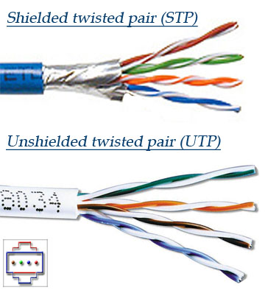
PHYSICAL MEDIA
Bit: propagates between transmitter/receiver pairs
Physical link: what lies between transmitter & receiver
Guided media:
signals propagate in solid media: copper, fiber, coax
Unguided media:
signals propagate freely, e.g., radio
Twisted pair (TP)
Two insulated copper wires
Category 5: 100 Mbps, 1 Gbps Ethernet
Category 6: 10Gbps
Notes:
The wires are twisted together to reduce the electrical interference from similar pairs close by.
Typically, a number of pairs are bundled together in a cable by wrapping the pairs in a protective shield. A wire pair constitutes a single communication link.

Slide 15


PHYSICAL MEDIA: COAX, FIBER
coaxial cable:
two concentric copper conductors
quite common in cable television systems
bidirectional
broadband:
multiple channels on cable
fiber optic cable:
glass fiber carrying light pulses, each pulse a bit
high-speed operation:
high-speed point-to-point transmission (e.g., 10’s-100’s Gbps transmission rate)
low error rate:
repeaters spaced far apart (~100km)
immune to electromagnetic noise
Notes:
Copper conductor: dây dẫn đồng
With this construction and special insulation and shielding, coaxial cable can achieve high data transmission rates. Specifically, a number of end systems can be connected directly to the cable, with each of the end systems receiving whatever is sent by the other end systems.

Slide 16
PHYSICAL MEDIA: RADIO
Signal carried in electromagnetic spectrum
No physical “wire”
Can penetrate wall
Potentially carry a signal for long distances
Bidirectional
Propagation environment effects:
reflection
obstruction by objects
interference
radio link types:
Terrestrial microwave
e.g. up to 45 Mbps channels
LAN (e.g., WiFi)
54 Mbps or more
Wide-area (e.g., cellular)
4G, 5G cellular
Satellite
Kbps to 45Mbps channel (or multiple smaller channels)
280 msec end-end delay
geosynchronous versus low altitude

Slide 17
5. Network core

Slide 18
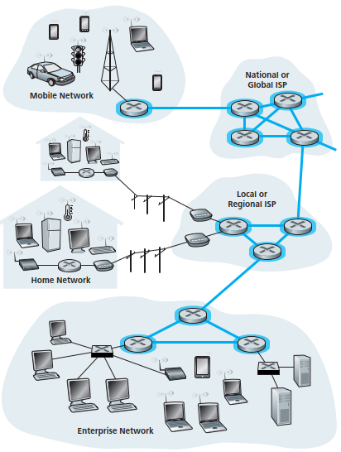
THE NETWORK CORE
Mesh of interconnected routers
Packet-switching: hosts break application-layer messages into packets
Forward packets from one router to the next, across links on path from source to destination
Each packet transmitted at full link capacity
Network Core

Slide 19
NETWORK CORE FUNCTIONS
routing: determines source-destination route taken by packets
routing algorithms
forwarding: move packets from routers input to appropriate router output
routing algorithm
local forwarding table
header value
output link
0100
0101
0111
1001
3
2
2
1
1
3
2
0111
destination address in arriving
packet’s header
Notes:
- When a packet arrives at a router, the router examines the address and searches its forwarding table, using this destination address, to find the appropriate outbound link. The router then directs the packet to this outbound link.

Slide 20

HOST SENDS PACKETS OF DATA
Host sending function:
Takes application message
Breaks into smaller chunks, known as packets, of length L bits
Transmits packet into access network at transmission rate R
Link transmission rate, aka link capacity, aka link bandwidth
two packets,
L bits each
2
1
R: link transmission rate
host
=
time needed to
transmit L-bit
packet into link
L (bits)
R (bits/sec)
Packet transmission delay
=
Notes:
Packets are transmitted over each communication link at a rate equal to the full transmission rate of the link.

Slide 21
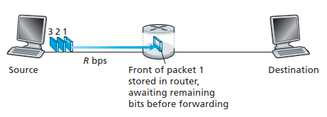

PACKET-SWITCHING: STORE-AND-FORWARD TRANSMISSION
End-to-end delay if a path has N links (R rate/link) (or N-1 routers):
Takes L/R seconds to transmit (push out) L-bit packet into link at R bps
Store and forward: entire packet must arrive at router before it can be transmitted on next link
end-end delay = 2L/R (assuming zero propagation delay)
One-hop numerical example:
L = 7.5 Mbits
R = 1.5 Mbps
one-hop transmission delay = 5 sec

Slide 22
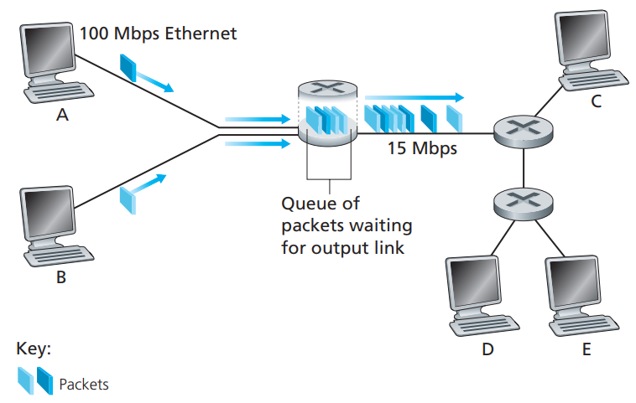
PACKET-SWITCHING: QUEUEING DELAY & PACKET LOSS
Delay:
Store-and-forward delays
Queuing delays
Propagation delays
Queuing and loss:
If arrival rate (in bits) to link exceeds transmission rate of link for a period of time:
packets will queue, wait to be transmitted on link
packets can be dropped (lost) if memory (buffer) fills up
Notes:
- If an arriving packet needs to be transmitted onto a link but finds the link busy with the transmission of another packet, the arriving packet must wait in the output buffer.
Lưu ý phân biệt store-and-forward delay vs queuing delay → (1) là chờ cho đủ các bit để truyền, (2) là chờ để môi trường idle để truyền.
Animation: http://computerscience.unicam.it/marcantoni/reti/applet/QueuingAndLossInteractive/1.html

Slide 23
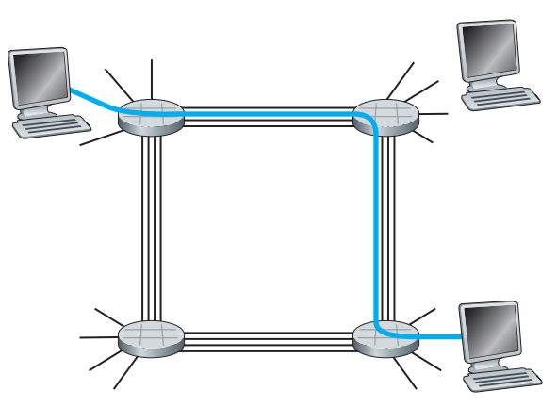
CIRCUIT SWITCHING
End-end resources allocated to, reserved for “call” between source & dest:
in diagram, each link has four circuits.
call gets 2nd circuit in top link and 1st circuit in right link.
dedicated resources: no sharing
circuit-like (guaranteed) performance
reserves a constant transmission rate (a fraction of link’s trans. capacity)
circuit segment idle if not used by call (no sharing)
commonly used in traditional telephone networks
End- to-end connection between the two hosts
- Four circuit switches are interconnected by four links
- Each of these links has four circuits
Notes:
Tham khảo thêm: https://www.youtube.com/watch?v=9JqaMOK_Xaw

Slide 24
PACKET SWITCHING versus CIRCUIT SWITCHING
Packet Switching | Circuit Switching
The message is broken down into small packets Every packet follows a different route | Entire message is passed There is a dedicated communication link
Not suitable for real-time services (because of its variable & unpredictable end-to-end delays) | - Excellent for real-time communications
- Better sharing of transmission capacity | - When no data is transmitted, capacity is unused, but still committed.
- Simpler, less costly | - More complicated
- Allocates link use on demand | - Pre-allocates use of the transmission link regardless of demand

Slide 25
6. Network topology

Slide 26
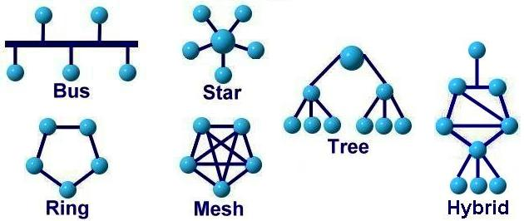
NETWORK TOPOLOGY
Network topology is the arrangement of the elements (links, nodes, etc.) of a communication network.
There are two approaches to network topology: physical and logical.
Physical network topology refers to the physical connections and interconnections between nodes and the network—the wires, cables, and so forth.
Logical network topology refers to the conceptual understanding of how and why the network is arranged the way it is, and how data moves through it.
Notes:
Tôpô vòng và lưới thường thích hợp với truyền dẫn đồng cấp (peer-to-peer).
Tôpô sao và cây thường thích hợp cho truyền dẫn sơ cấp- thứ cấp (server-client hoặc primary-secondary).
Tôpô bus thích hợp cho cả hai dạng: đồng cấp và sơ cấp- thứ cấp.
Tham khảo thêm: https://www.dnsstuff.com/what-is-network-topology

Slide 27
7. Network Performance

Slide 28

FOUR SOURCES OF PACKET DELAY
transmission
A
propagation
B
nodal
processing
queueing
d_{nodal} = d_{proc} + d_{queue} + d_{trans} + d_{prop}
d_{proc}: nodal processing
check bit errors
examine the packet’s header
determine output link
typically < ms
d_{queue}: queueing delay
time waiting at output link for transmission onto the link
depends on congestion level of router (traffic is heavy or not)
the order of microseconds to milliseconds in practice

Slide 29
FOUR SOURCES OF PACKET DELAY
transmission
A
propagation
B
nodal
processing
queueing
d_{nodal} = d_{proc} + d_{queue} + d_{trans} + d_{prop}
d_{trans}: transmission delay:
the amount of time required to push all of the packet’s bits into the link
L: packet length (bits)
R: link bandwidth (bps) or trans. rate
d_{trans} = L/R
On the order of microseconds to milliseconds
d_{prop}: propagation delay:
time required to propagate from the beginning of the link to the next destination
Depends on the physical medium
d: length of physical link
s: propagation speed (~2x10⁸ m/sec – 3x10⁸ m/sec)
d_{prop} = d/s
d_{trans} and d_{prop}
very different

Slide 30
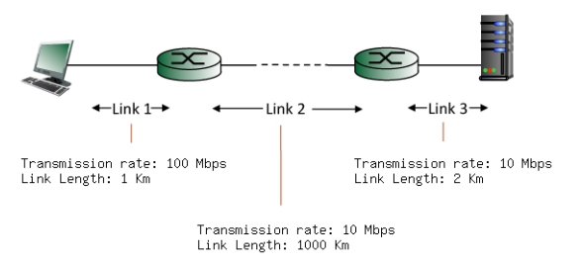
Exercise: Computing transmission & propagation delay
Consider the figure below, with three links, each with the specified transmission rate and link length.
Find the end-to-end delay (including the transmission delays and propagation delays on each of the three links, but ignoring queueing delays and processing delays) from when the left host begins transmitting the first bit of a packet to the time when the last bit of that packet is received at the server at the right. The speed of light propagation delay on each link is 3x10**8 m/sec. Note that the transmission rates are in Mbps and the link distances are in Km. Assume a packet length of 4000 bits. Give your answer in milliseconds.

Slide 31
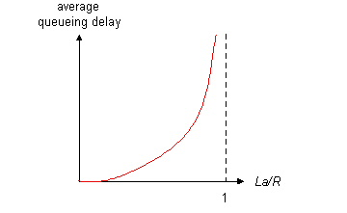

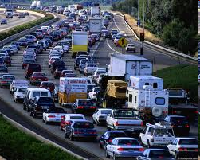
QUEUEING DELAY (REVISITED)
R: transmission rate (bps) = rate at which bits are pushed out of the queue
L: packet length (bits)
a: average packet arrival rate
→La: average rate at which bits arrive at the queue
When is the queuing delay large and when is it insignificant?
Depends on:
Arriving rate at the queue
Transmission rate of the link
Nature of the arriving traffic (traffic arriving pattern)
average queueing delay
traffic intensity
= La/R
La/R ~ 0: avg. queueing delay small
La/R -> 1: avg. queueing delay large
La/R > 1: more “work” arriving
than can be serviced, average delay infinite!
La/R < 1: nature of the arriving traffic affects the queuing delay
La/R ~ 0
Design your system so that the traffic intensity is no greater than 1.
La/R -> 1
Notes:
Unlike the other three delays (namely, dproc, dtrans, and dprop), the queuing delay can vary from packet to packet.
For example, if 10 packets arrive at an empty queue at the same time, the first packet transmitted will suffer no queuing delay, while the last packet transmitted will suffer a relatively large queuing delay (while it waits for the other nine packets to be transmitted).
Chính vì vậy khi xem xét queuing delay người ta thường quan tâm các giá trị statistical: average queuing delay, variance of queuing delay….
Animation: http://www.ccs-labs.org/teaching/rn/animations/queue/

Slide 32
PACKET LOSS
Queue (aka buffer) preceding link in buffer has finite capacity
Packet arriving to full queue dropped (aka lost)
Lost packet may be retransmitted by previous node, by source end system, or not at all
buffer
(waiting area)
A
packet being transmitted
B
packet arriving to
full buffer is lost
Notes:
Animation: http://www.ccs-labs.org/teaching/rn/animations/queue/

Slide 33
THROUGHPUT
throughput: rate (bits/time unit) at which bits transferred between sender/receiver
instantaneous: rate at given point in time
average: rate over longer period of time
server, with
file of F bits
to send to client
link capacity
R_{s} bits/sec
link capacity
R_{c} bits/sec
server sends bits
(fluid) into pipe
pipe that can carry
fluid at rate
R_{s} bits/sec)
pipe that can carry
fluid at rate
R_{c} bits/sec)
Notes:
Rs: the rate of the link between the server and the router;
Rc: the rate of the link between the router and the client.

Slide 34
THROUGHPUT
R_{s} < R_{c} What is average end-end throughput?
R_{s} bits/sec
R_{c} bits/sec
R_{s} > R_{c} What is average end-end throughput?
R_{s} bits/sec
R_{c} bits/sec
bottleneck link
link on end-end path that constrains end-end throughput
Notes:
If Rs < Rc, then the bits pumped by the server will “flow” right through the router and arrive at the client at a rate of Rs bps, giving a throughput of Rs bps. If, on the other hand, Rc < Rs, then the router will not be able to forward bits as quickly as it receives them. In this case, bits will only leave the router at rate Rc, giving an end-to-end throughput of Rc.

Slide 35
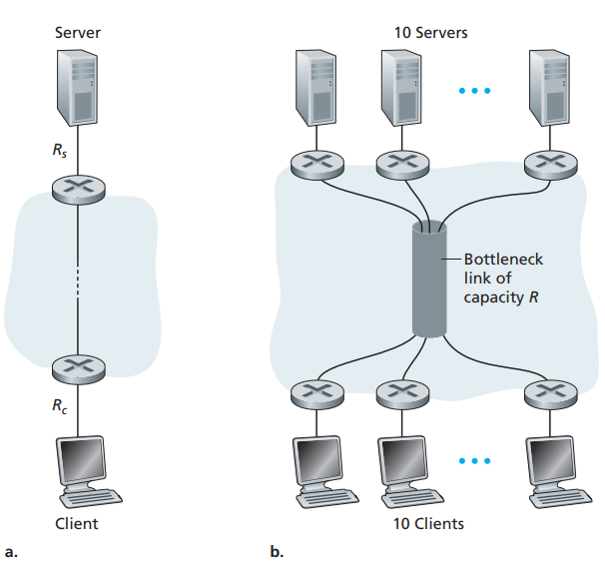
THROUGHPUT: INTERNET SCENARIO
Per-connection end-end throughput: min(R_{c},R_{s},R/10)
In practice: R_{c} or R_{s} is often bottleneck (access network) because the core of the Internet is over-provisioned with high speed links that experience little congestion
10 connections (fairly) share backbone bottleneck link R bits/sec

Slide 36
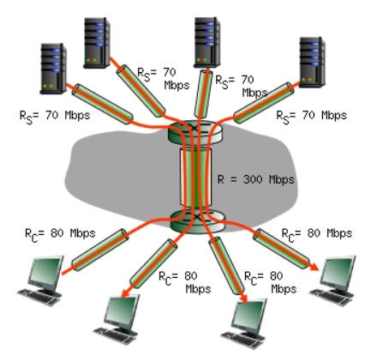
THROUGHPUT: EXERCISE
Consider the scenario shown below, with four different servers connected to four different clients over four three-hop paths. The four pairs share a common middle hop with a transmission capacity of R = 300 Mbps. The four links from the servers to the shared link have a transmission capacity of R_{S} = 70 Mbps. Each of the four links from the shared middle link to a client has a transmission capacity of R_{C} = 80 Mbps per second. You might want to review Figure 1.20 in the text before answering the following questions:
What is the maximum achievable end-end throughput (in Mbps) for each of four client-to-server pairs, assuming that the middle link is fair-shared (i.e., divides its transmission rate equally among the four pairs)?
Which link is the bottleneck link for each session?
Assuming that the senders are sending at the maximum rate possible, what are the link utilizations for the sender links (R_{S}), client links (R_{C}), and the middle link (R)?

Slide 37
8. Internet Structure

Slide 38
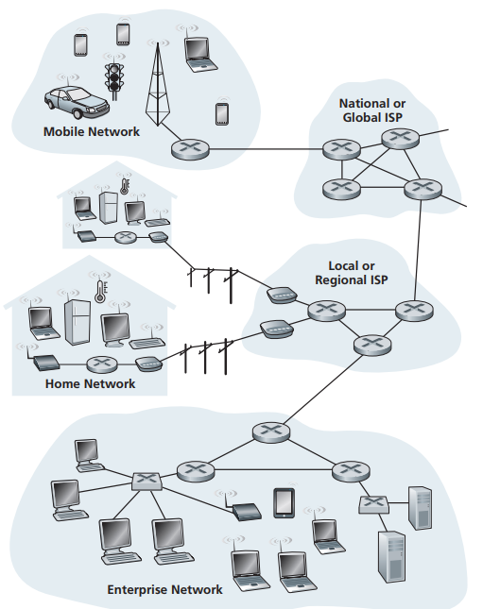
INTERNET STRUCTURE: NETWORK OF NETWORKS
End systems connect to Internet via access ISPs (Internet Service Providers)
residential, company and university ISPs
Access ISPs in turn must be interconnected.
so that any two hosts can send packets to each other
Resulting network of networks is very complex
evolution was driven by economics and national policies rather than by performance considerations.
Let’s take a stepwise approach to describe current Internet structure

Slide 39
INTERNET STRUCTURE: NETWORK OF NETWORKS
Question: given millions of access ISPs, how to connect them together?
…
…
access
net
access
net
access
net
access
net
access
net
access
net
access
net
…
…
access
net
access
net
access
net
access
net
access
net
access
net
…
access
net
access
net
…
access
net

Slide 40
INTERNET STRUCTURE: NETWORK OF NETWORKS
Option: connect each access ISP to every other access ISP?
…
…
access
net
access
net
access
net
access
net
access
net
…
…
access
net
access
net
…
connecting each access ISP to each other directly doesn’t scale: O(N²) connections.
…
…
access
net
access
net
…
access
net
access
net
access
net
…
access
net
…
access
net
access
net
…
access
net

Slide 41
INTERNET STRUCTURE: NETWORK OF NETWORKS
Option: connect each access ISP to one global transit ISP?
Customer and provider ISPs have economic agreement.
…
…
access
net
access
net
access
net
access
net
access
net
access
net
access
net
…
…
global ISP
access
net
access
net
access
net
access
net
access
net
access
net
…
access
net
access
net
…
access
net
Notes:
Since the access ISP pays the global transit ISP, the access ISP is said to be a customer and the global transit ISP is said to be a provider

Slide 42
INTERNET STRUCTURE: NETWORK OF NETWORKS
But if one global ISP is viable business, there will be competitors …. which must be interconnected
Internet exchange point
…
…
access
net
access
net
access
net
access
net
access
net
IXP
access
net
access
net
ISP A
…
…
access
net
IXP
ISP B
access
net
ISP C
access
net
access
net
peering link
access
net
access
net
…
access
net
access
net
…
access
net

Slide 43
INTERNET STRUCTURE: NETWORK OF NETWORKS
… and regional networks may arise to connect access nets to ISPs
Internet exchange point
access
net
access
net
…
access
net
access
net
access
net
IXP
access
net
access
net
ISP A
…
…
access
net
IXP
ISP B
access
net
ISP C
access
net
peering link
access
net
access
net
regional net
access
net
…
access
net
access
net
…
access
net
Notes:
In reality, although some ISPs do have impressive global coverage and do directly connect with many access ISPs, no ISP has presence in each and every city in the world. Instead, in any given region, there may be a regional ISP to which the access ISPs in the region connect.

Slide 44
INTERNET STRUCTURE: NETWORK OF NETWORKS
… and content provider networks (e.g., Google, Microsoft, Akamai) may run their own network, to bring services, content close to end users
Internet exchange point
access
net
access
net
…
access
net
access
net
access
net
IXP
access
net
access
net
ISP A
…
…
Content provider network
access
net
IXP
ISP B
access
net
ISP C
access
net
peering link
access
net
access
net
regional net
access
net
…
access
net
access
net
…
access
net

Slide 45
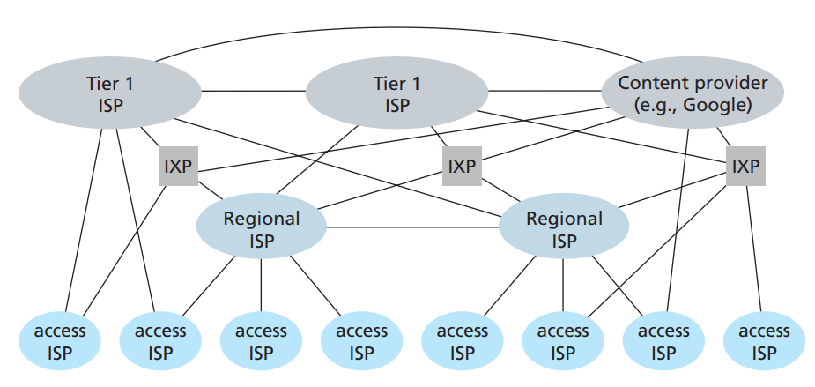
INTERNET STRUCTURE: NETWORK OF NETWORKS
Notes:
IXP: Internet Exchange Point → meeting point where multiple ISPs can peer together.

Slide 46
9. OSI model & TCP/ip Model

Slide 47
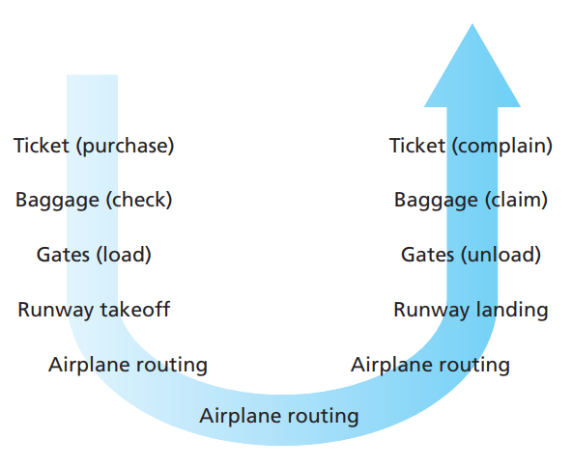
ORGANIZATION OF AIR TRAVEL
Describe the airline system
a series of steps → But there are functions repeated!!

Slide 48
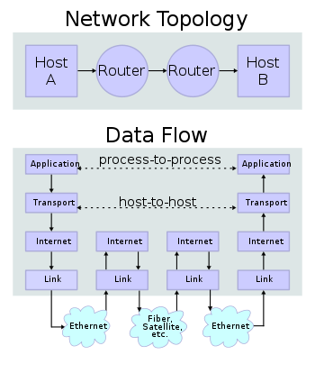
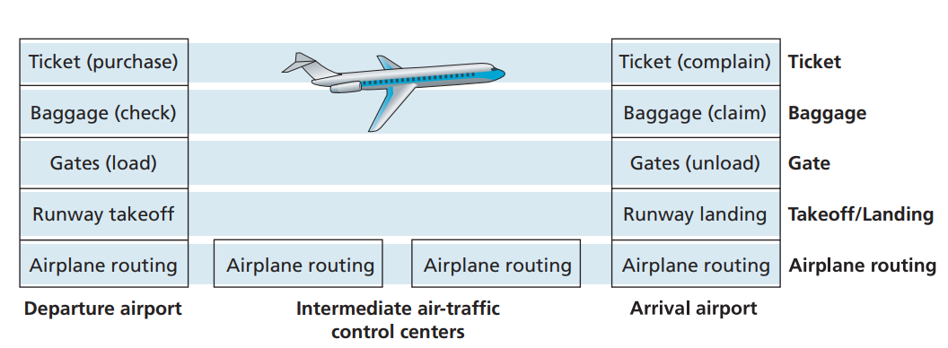
LAYERING OF AIRLINE FUNCTIONALITY
Look at the functionality in a horizontal manner
→ The airline functionalities are divided into layers
Layers: each layer implements a service
by performing certain actions within that layer
relying on services provided by layer below

Slide 49
INTERNET PROTOCOL STACK
Application: supporting network applications
FTP, SMTP, HTTP, DNS
The app. in one end system using the protocol to exchange message (packets of information) with the app. in another end system
Transport: process-process data transfer, flow control
TCP, UDP
Reliable end-to-end delivery service
Transport application-layer messages
Transport-layer packet = segment
Network: routing of IP packet from source to destination
Provides the service of delivering the segment through a series of routers to the transport layer in the destination host
IP, routing protocols
Link-layer: data transfer between neighboring network elements
To move a frame from one node to the next node in the route
Reliable delivery between 2 adjacent nodes
Ethernet, 802.11 (Wi-Fi), PPP
Physical: bits “on the wire” → Move individual bits within the frame from one node to the next
application
transport
network
link
physical

Slide 50
OSI REFERENCE MODEL
presentation: allow applications to interpret meaning of data, e.g., encryption, compression, machine-specific conventions
session: synchronization, checkpointing, recovery of data exchange
Internet stack “missing” these layers!
these services, if needed, must be implemented in application
needed?
application
presentation
session
transport
network
link
physical

Slide 51
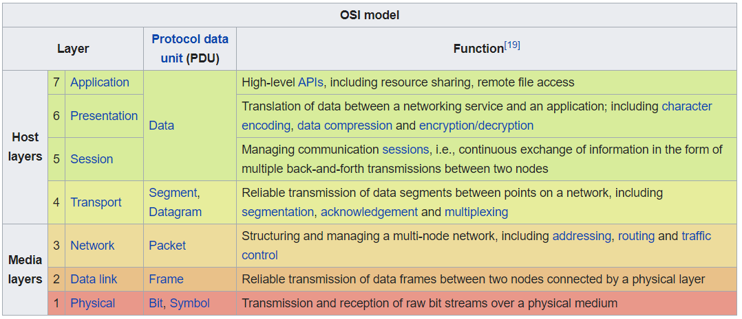
OSI REFERENCE MODEL

Slide 52
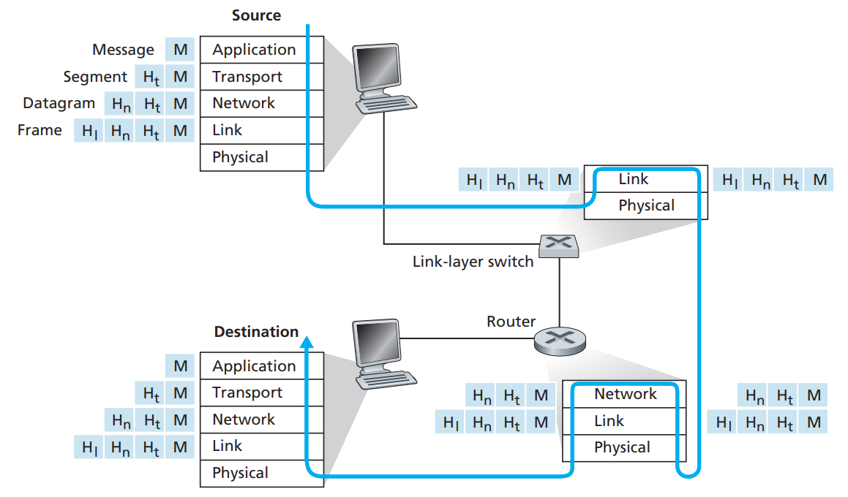
ENCAPSULATION
Figure shows the physical path:
data takes down a sending end system’s protocol stack
up and down the protocol stacks of a link-layer switch and router
up the protocol stack at the receiving end system.
A packet has two types of fields: header fields and a payload field.
The payload is typically a packet from the layer above.

